Slide 1



TEAM J Folasewa Abdulsalam, Adenike Adesanya, Ibrahim Murtala, Amaobichuckwu Chibuzor A Knowledge based Web-app Predictive System for CO2 Emission.

Slide 2

Hi!
My name is Maryam
I am the team lead for Team J and I am here to walk you through our AI software solution and research poster, the technical details surrounding the solution, its working mechanism, and its value to business owners.

Slide 3
The Big Question? What problem is team J solving and what solution are we profering?
1

Slide 4
῾ I don’t think you have a choice but to pull CO2 back that has already made it out, or is about to make it out, because we are not overnight shutting down all the coal plants ᾽.
Klaus Lackner

Slide 5
Guess what?
The most popular energy sector is the oil and gas.
But then, we went deeper into the oil and gas operations and found out that oil and gas is not all about oil.
Oil and gas companies take up major capital projects that involve lots of construction activities and this involves the intensive use of cement..

Slide 6
During the clinker production of cement making, CO2 is being emitted as a by product and this contributes to about 8% of global CO2 emissions, according to think tank Chatham House.
If the cement industry were a country, it would be the third largest emitter in the world-behind China and US.

Slide 7
Solution?
In tackling this, we hereby propose a knowledge-based web-app predictive system for CO2 emission at the point of clinker production during the manufacturing of cement.

Slide 8
Academic Poster Session
Let me briefly bring your attention to the technicalities of the solution that is the whole data science and machine learning process.

Slide 9
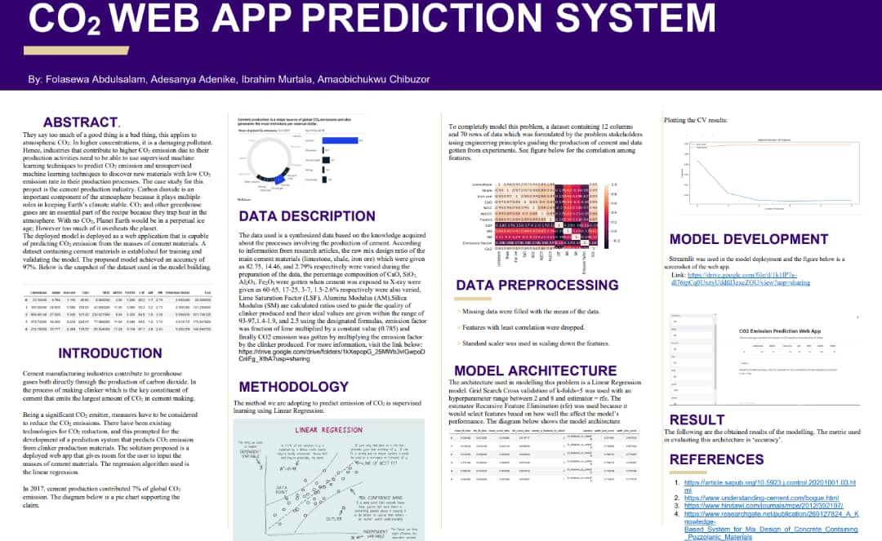

Slide 10
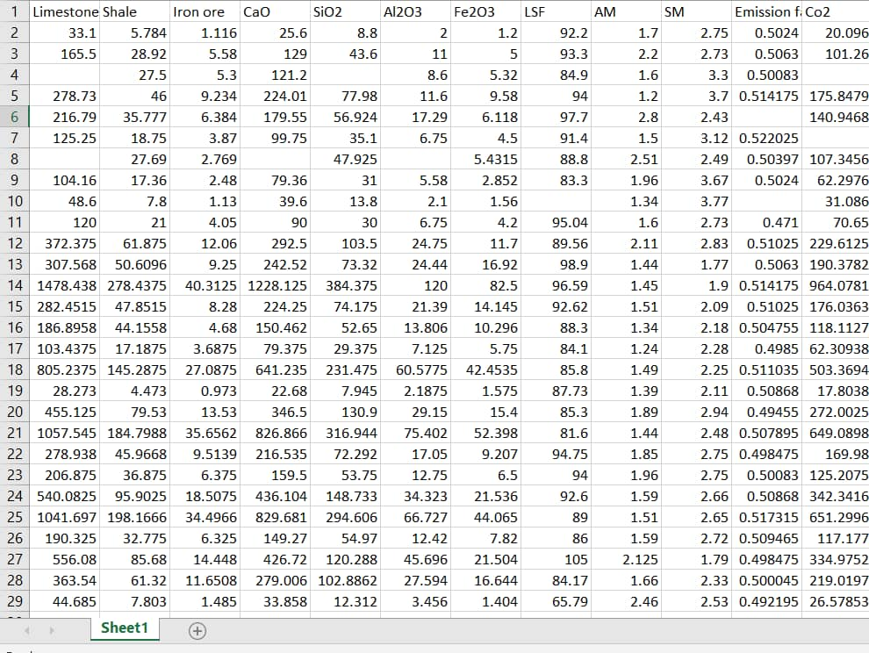
Dataset

Slide 11
Roadmap-A pipeline for the poster
Data Sourcing
Data Preprocessing
Results
References
1
3
5
7
2
4
6
Methodology
Model Architecture
Model Deployment

Slide 12
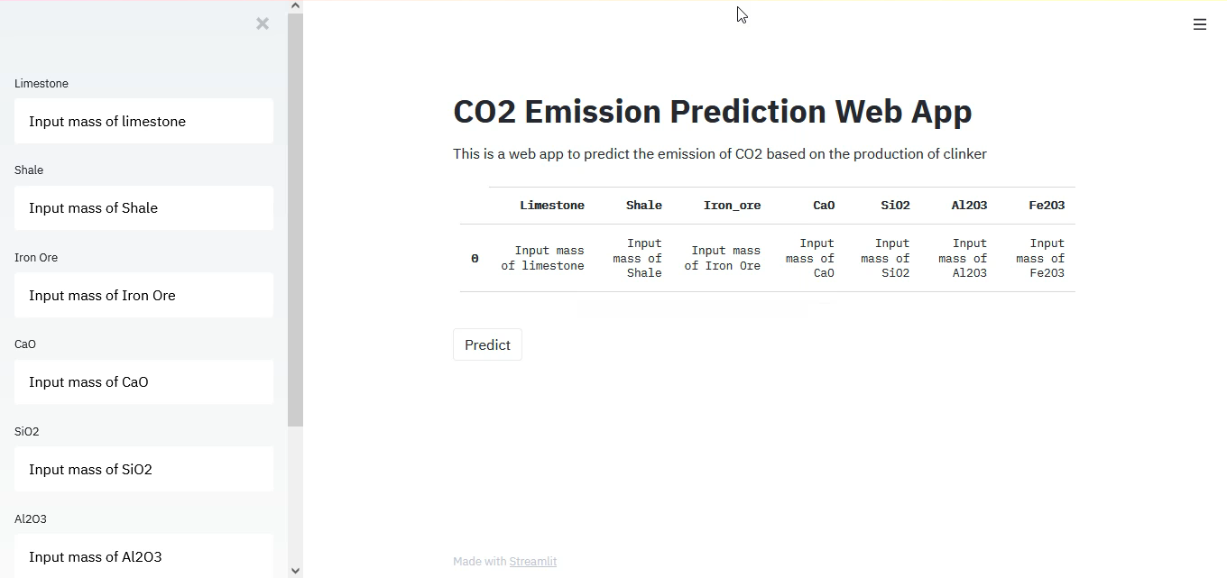

Slide 13
Key Takeaways from the video
The web-application is a white-box AI model .
It is simple to use and it is intuitive
It is scalable

Slide 14
Value? Where do we see our solution being used in the business world and how can it help reduce CO2?
from the engineering managers to the engineering CEO the app can help in making data driven decisions.
the output can be used by companies to prove that their operations are green.

Slide 15
Reflections?
How can we make this solution better?
more intuitive user interface .
discovery of new materials with low carbon emission.
a voting algorithm (for robustness) can be considered as part of the model building.
time forecasting can be implemented.

Slide 16
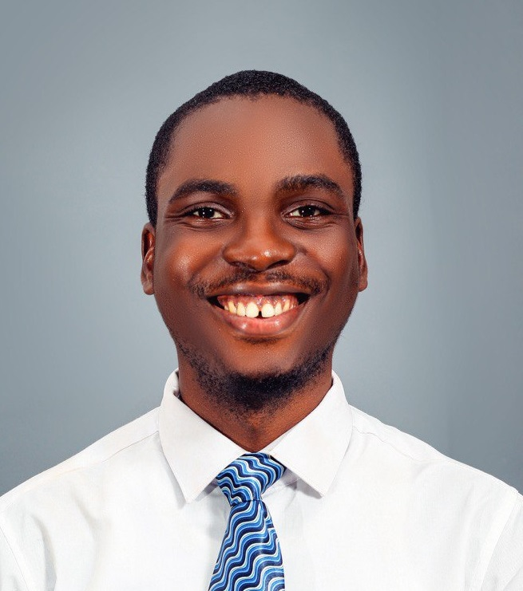


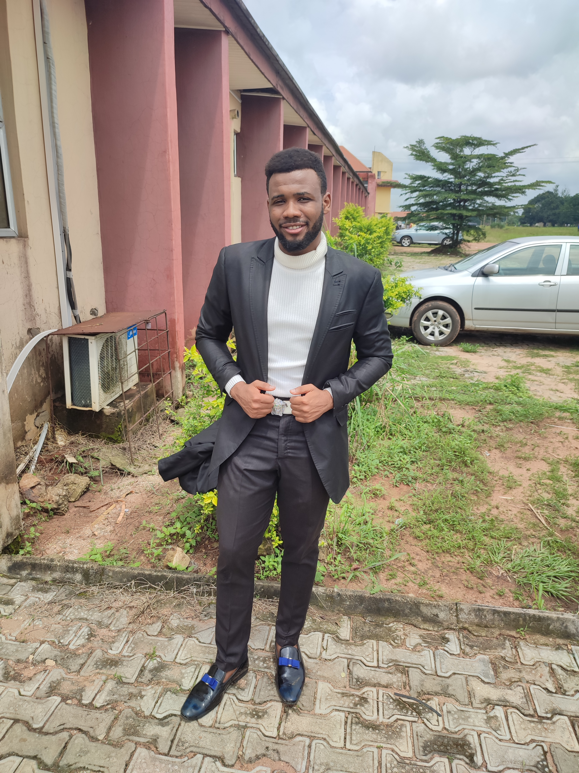
Meet The Team
Chukwudum Chuckwuedo Mentor from Chevron
Digital Engineer
Maryam Folasewa Abdulsalam Team Lead
Machine Learning Engineer
400L Computer Science and Maths, OAU
Adenike Oyinkasola Adesanya C# Programmer
300L Computer Science, Mountain Top
Ibrahim Murtala Muhammad Basic ML
300L Chemical Enineering, ATBU.
Amaobichuckwu Chibuzor IOT, Basic ML
Petroleum Engineering Finalist, FUTO.

Slide 17
THANKS!
Any questions?

